Slide 1
RADICAL Cybertools
Research in Advanced DIstributed Cyberinfrastructure and Applications Laboratory (RADICAL)
http://radical.rutgers.edu

Slide 2
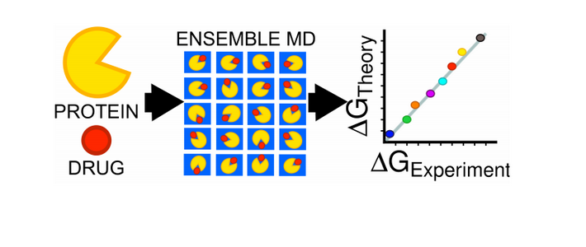
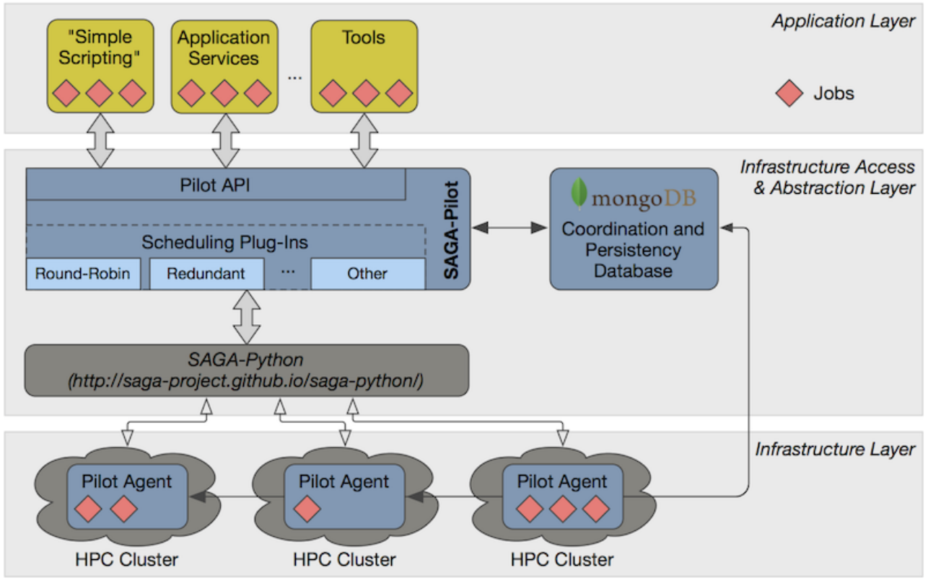
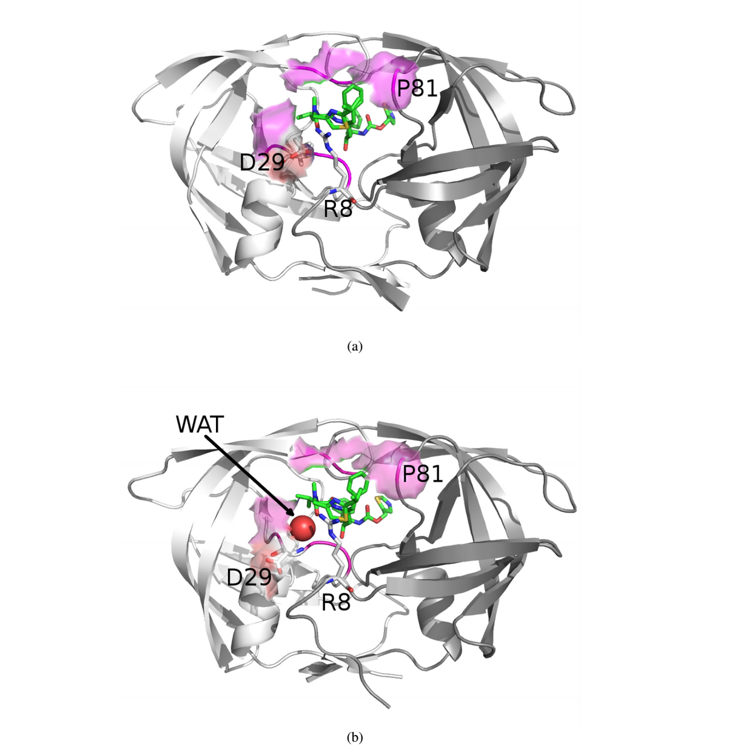
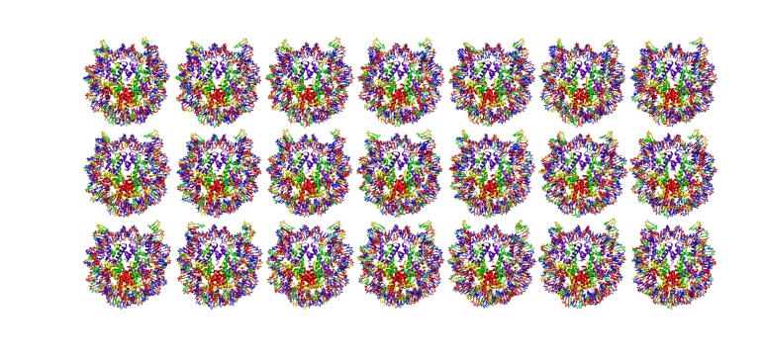
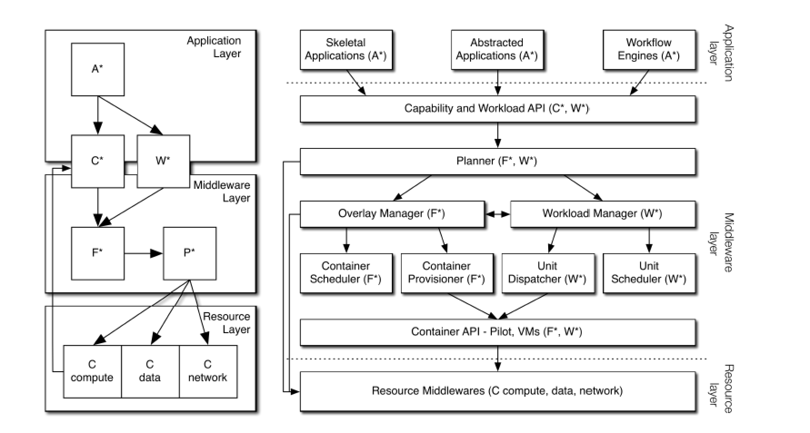
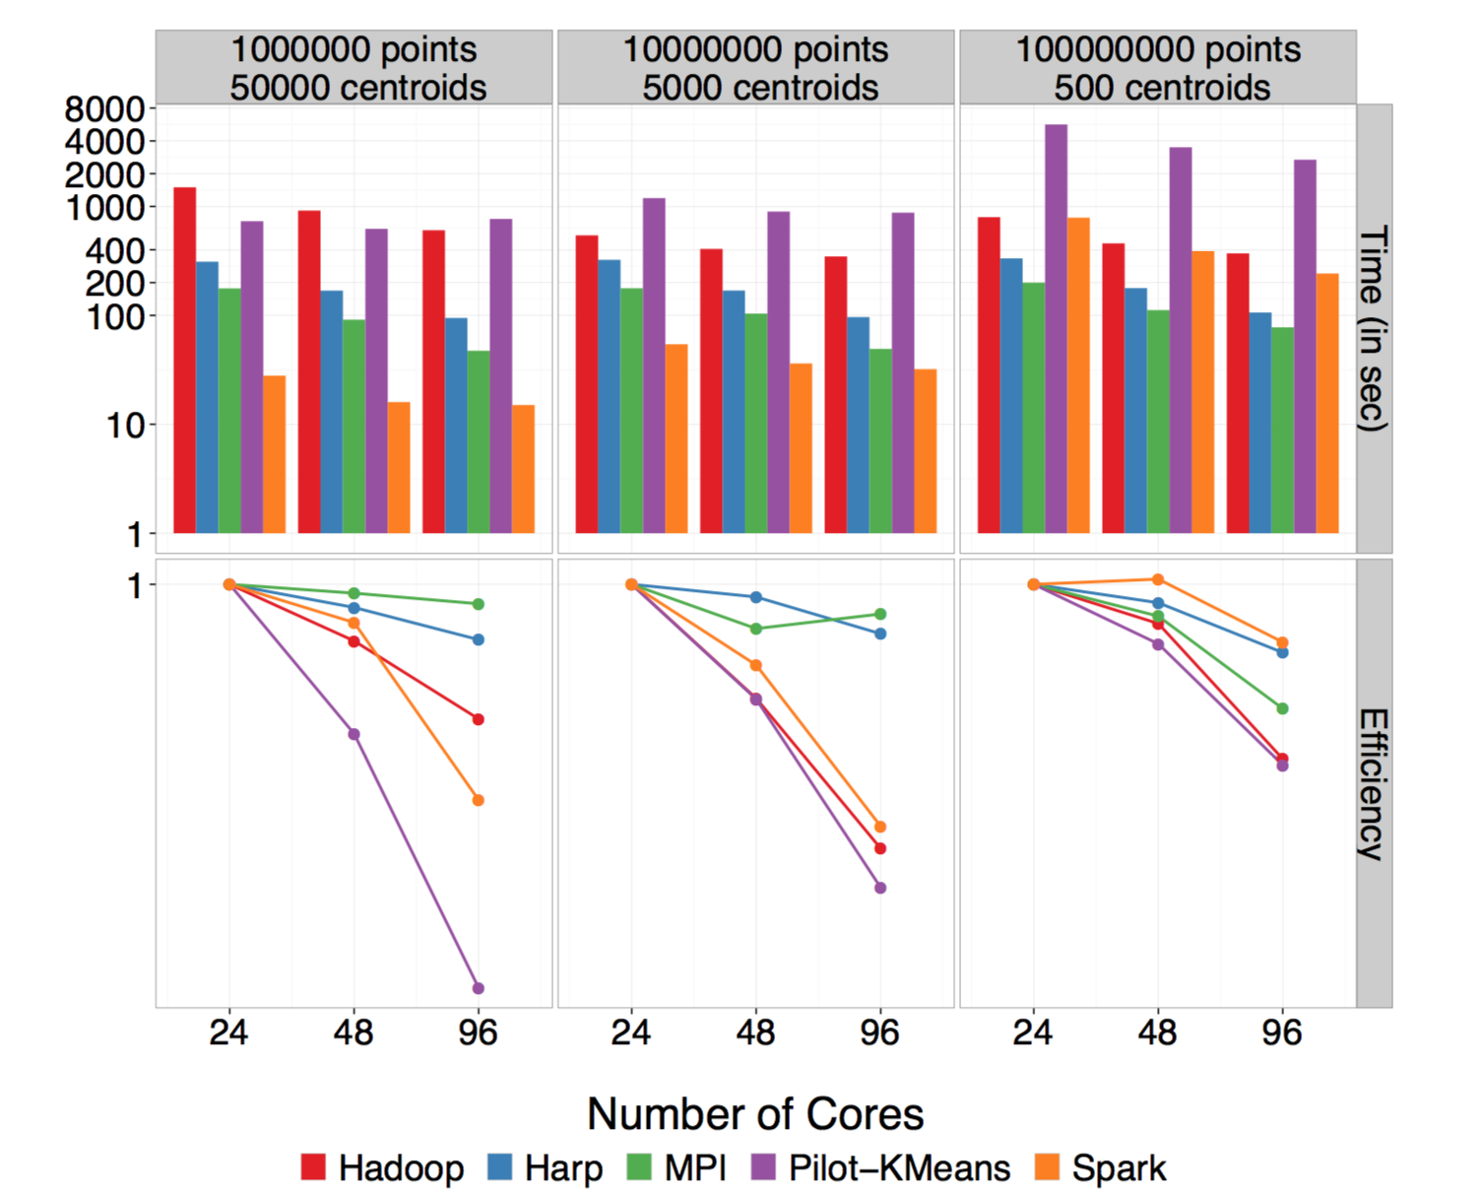
RADICAL: Research in Advanced Distributed Cyberinfrastructure Lab http://radical.rutgers.edu/projects/radical-cybertools/
Specific Approach: (i) Understand Application requirements, (ii) adapt tools and approaches, (iii) refine and optimize for scalable, extensible end-to-end solutions
General Approach: Build Tools that Make Using XSEDE easier (manage compelxity of distribution and heterogeneity) efficient (small software footprint) and effective (meet user requirements)

Slide 3
RADICAL: Research in Advanced Distributed Cyberinfrastructure Lab
The RADICAL group applies high-performance distributed computing to advance science and engineering. We develop both the theoretical underpinnings as well as implement the tools and abstractions to support science at extreme-scales.
AIMES: Designing the next generation middleware for distributed cyberinfrastructure
ExTASY: Abstractions and Tools for the enhanced Sampling of Bio-molecular Ensembles

Slide 4
Overview
AIMES: Abstractions and Integrated Middleware for Extreme Scale
Research
Development
RADICAL Cybertools
SAGA
SAGA-Pilot (next generation BigJob)
TROY
Next Generation Middleware Track
Research
Functional Aim: Well-defined Capabilities & Predictable Services
Approach: Models at multiple levels and their integration: Applications (A*, W*), Dynamic Resources (P*), Infrastructure (I*), Federation (F*)
Development: Putting it all together Implementation

Slide 5
Why Distributed Exascale Computing?
Support new science and new usage modes
Different modes of exascale computing
“Ensemble based” versus “single hero based”
Coupling exaflops of computing with exabytes of data
Existing and future DoE Applications and facilities
Complex, multi-component, distributed data and workflow based
Efficient and effective utilization of collective set of resources
Offload workloads from leadership to less powerful machines
Onload workloads from distributed systems onto leadership
Strategically and synergistically, not competitively
Support the “long tail of science” and existing application requirements
Scale as many scalable concurrent applications
Notes:
Onload: time-critical, critical components which can’t be fully estimated…

Slide 6
Extreme-Scale Distributed Computing in 2013
First generation of DC characterized by “gluing it” together
Many local solutions, lack of end-to-end solutions
Inability to reason about spatio-temporal execution properties
Given a general workload there is an inability to estimate how long a workload will take? And where (and why) it will execute?
Complete absence of analytical models of applications, infrastructure
And we do not know how wrong our estimates would be!
We are still learning how to architect large-scale systems
Scaling remains difficult for individual scientists
< 1% can do O(100) tasks of O(10GB) over O(10) nodes
Macroscopic vs microscopic theory of distributed systems!
Missing principles and practice of “systems in the large”

Slide 7
DEC Foundational Requirements
Support novel and broad range of application requirements
Large-scale simulations integrated with distributed big-data analysis (ATLAS, HEP)
Real-time computing coupled with distributed data from scientific experiments (LSST, SKA)
Federate diversified set of resources
Manage complexity, heterogeneity and dynamism of infrastructure
Resultant “balanced” infrastructure that supports scaling along several dimensions (scaling up, out, across..)
Support for adaptive applications and dynamic resources
Move away from static execution to co-execution
Starting point for flexible execution involving multi-level and integrated information
Notes:
Bear with me if this seems incremental progress or repetitive, but I think its important to ensure that we’re on the same page --- about the granularity and the challenges

Slide 8
DEC in Relation to “Traditional” EC
There are many application types as opposed to a set of kernels that need to optimized
Metrics of performance varied, i.e. not just peak performance
Builds upon energy, resilience and performance
Application structure simple, but infrastructural requirements difficult
Task-level composition and coordination is important and varied
External data infrastructure, repositories
Design to support exascale collectively for many scalable applications on “production” infrastructure
Community (HEP) applications, essentially similar
Explains why DC software environment is complex, points to an important role for middleware
Middleware: Platform to build common and integrated services, whilst hiding heterogeneous software & system access layers

Slide 9
AIMES Context
Distributed computing is one pathway to extreme-scale and a necessity for collaboration
The Problem
Current state of distributed applications and infrastructure is problematic
Two situations predominate:
Applications are inflexible: optimized and pinned to a specific platform
Applications are flexible: run anywhere but performance is unpredictable
The Hypothesis
Flexibility and performance are compatible!
Extracting Simplicity whilst managing Complexity requires abstractions
Abstractions and Models are key to “reason about distribution”
The Solution
We advance middleware abstractions that will facilitate reasoning integrated across application and resource level
AIMES: Integrated approaches to Resource Management
Notes:
Problem statement was valid 10 years ago. What has changed in 10 years? Need/want to reason
Current State: M-to-M A-I, but we can think of it as a challenge to map 1-to-many, many-to-1
“managing complexity is not the same as extracting simplicity” ---- requires abstractions!

Slide 10



AIMES
Explore the role of abstractions on the path to distributed extreme scale computing across heterogeneous resources – compute, data, networking.
Develop enabling middleware architecture that:
Integrates Abstractions (Skeletons, Pilots and Bundles)
Enables dynamic resource usage and adaptive workload management
Approach:
Synthetic workload generation to capture application characteristics
Pilot-based abstraction for dynamic resources
Prediction strategies for resource and capability availability.
Notes:
Three logos plus summary of what is AIMES about with focus on integration mentioned in the subtitle. What is a barrier to Extreme Scale- static resource utilization, dynamic workload and we couple the two. Integration is a necessity of making them dynamic. Why do we make it dynamic? Fundamental postulate of AIMES. When we have both dynamic we are more likely to reach exascale.

Slide 11
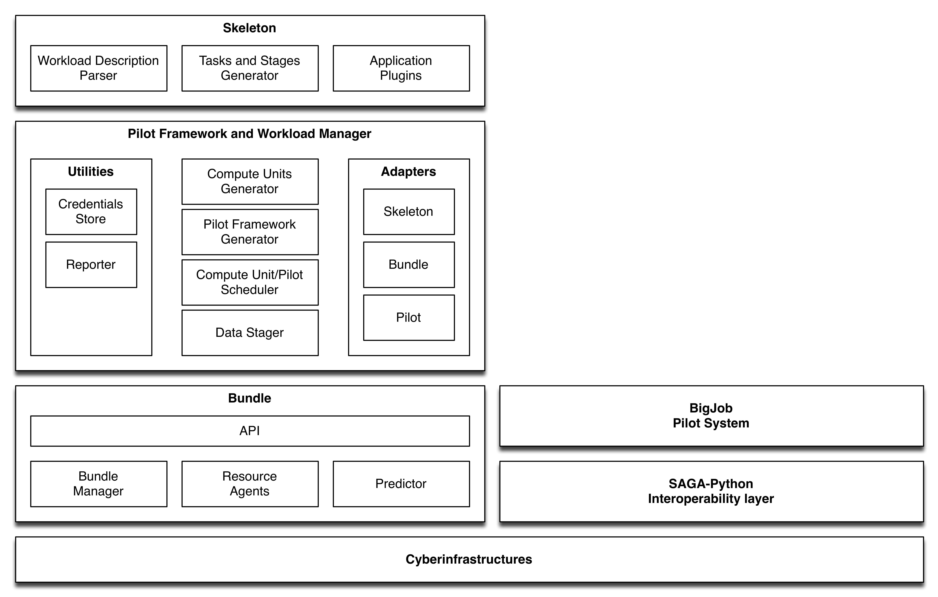
AIMES Architecture
Notes:
, i.e., no PRACE-style snobbery

Slide 12
AIMES Architecture
Use cases:
Bag of tasks (implemented): Executing homogeneous bag of tasks of O() scale on FutureGrid.
Replica exchange (year 2):.
Workflows (year 3):.
Benefits:
Creating synthetic applications from concise descriptions for testing and profiling purposes.
Transparent Integration and management of distributed resources within and across cyberinfrastructures.
Increased scalability due to automation of pilot framework description, instantiation and management.
Prediction of resource availability for smart task scheduling.
Notes:
, i.e., no PRACE-style snobbery

Slide 13
Bundle
High-level abstraction of resources:
Make multiple platforms such as batch-controlled supercomputers, grid and cloud appear to be a unified allocable resource pool.
Enables automatic, on-demand selection of appropriate resource that meets performance requirements.
Resource availability and performance prediction:
Estimate the wait time for K cores on platform P
Multi-method approach based on P
White box (knowledge of scheduling policy), Greybox speculation (system probes), Data-driven (use of historical data, continuous data collection).
Provide measurement and forecast of resource capacity including compute, storage and network (Year 2)
Constant monitor of resource variance to trigger notification to resource user after reaching threshold (Year 2)

Slide 14
Pilot Framework and Workload Manager
Integrates both skeletons and bundles:
Skeletons: translates across workload representations. Offers a unified internal representation suitable for multiple, specific-domain representations.
Bundles: leverages predictions about queuing time and information about resource capabilities, load and availability to choose suitable resources.
3 main decisions points:
Translating the given workload into a set of (correlated) Compute Units (CU). The granularity of such translation is free – i.e. 1 Task -> N CUs.
Define size, duration and location of Pilot Jobs. Evaluates and integrates requirements defined by the properties of the workload – e.g. level of concurrency, type of executable, relationship among tasks – with those of the available resources – e.g. capabilities, load, and likely behavior.
Control time of binding CUs to Pilots. Binding CUs before instantiating a pilot for workloads fully specified upfront or for highly available resources; Binding CU to instantiated pilots for iterative workloads and highly dynamic resources.

Slide 15
Experiments
Goal: Integrate, Enable, and Analyze – qualitatively and quantitatively -- dynamic resource and adaptive execution.
Multiple experiments to study the effect of the following variables either in isolation or together:
Coupling / similarity / dependency:
Bag of Tasks: Homogeneous and heterogeneous.
Replica Exchange: Communication steps predetermined or dynamic.
Workflows: Complex correlations among tasks and group of tasks.
Dynamics of task availability:
Single at a point in time: All the tasks of a workload are available at the choice points.
Discrete time steps: Group of tasks become available sequentially.
Continuous: Tasks are streamed.
Binding of tasks to resources:
Early: Tasks are bound to pilots before instantiating the pilots.
Late: Tasks are bound to pilot instances.
Data affinity and Computation scale.

Slide 16
Experiments
Goal: measure the relevance of early and late binding in relation to:
Performance: Measured as time to completion of the workload.
Scalability: Measures as number of concurrent tasks executed.
Control, responsibility, and flexibility: Analyzed as qualitative properties of different execution strategies.
The first three experiments assume:
Workload: Minimal coupling; maximal similarity; and no dependences – i.e. homogeneous bag of tasks.
Task availability: All available at time t₀.
Experiments: temporal composition of Workload (W), Pilot Overlay (O), and Resources (R):
Experiment 1: W | O | R. O is tailored to W and then bound to R.
Experiment 2: O | W | R. O is available but not bound to R.
Experiment 3: O | R | W. O is bound to R and W needs to be tailored to O.

Slide 17
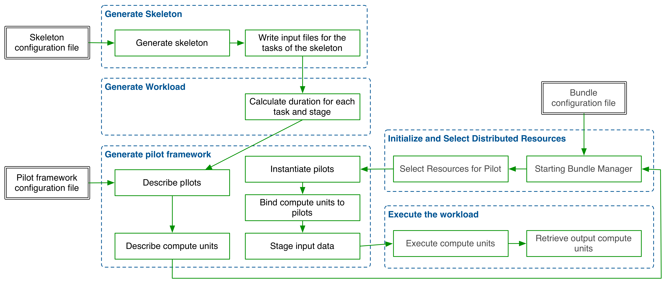
Experiment
Shows the integration among the three major components of the AIMES software stack.
Illustrates the major decision points around which the future development of the AIMES stack will evolve.

Slide 18
SAGA: Interoperability Layer for BigJob
SAGA – Simple API for Distributed (“Grid”) Applications:
Application level standardized (Open Grid Forum GFD.90) API.
Application is a broad term: “one person’s application is another person’s tool (building block)”.
SAGA-Python:
Native Python implementation of Open Grid Forum GFD.90.
Allows access to different middleware / services through a unified interface
Provides access via different backend plug-ins (“adaptors”).
SAGA-Python provides both a common API, but also unified semantics across heterogeneous middleware:
Transparent Remote operations (SSH / GSISSH tunneling).
Asynchronous operations.
Callbacks.
Error Handling.

Slide 19
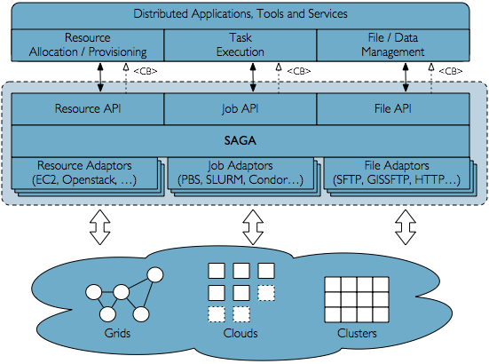
SAGA Schematic

Slide 20
SAGA: Interoperability layer
HOW SAGA is Used?
Uniform Access-layer to DCI, e.g, EGI, XSEDE, etc
Application “Scripting Layer” to DCI
Build tools, middleware services and capabilities e.g. Gateways,
WHAT is SAGA Used for?
Production-grade science and engineering and research tool to design, implement and reason about distributed programming models, systems and applications
Where is SAGA Used?
Pilot-job and Workflow systems, science gateways and web portals
Domain-specific (distributed) applications, libraries and frameworks

Slide 21
RADICAL-Pilot
Lightweight, portable, fast, scalable pilot framework
Focuses on enabling CS research
But may be able to support some “production” users
Focuses on pilot jobs, but will enable research on pilot data
Scalability (up and out)
Lightweight data model
Bulk operations
Notifications / support for async programming
Portability
Pure Python
Modular pilot agent
SAGA-Python as plumbing layer
Supports Research
Pluggable schedulers
High degree of introspection, provenance
Consistent and verifiable performance

Slide 22
RADICAL-Pilot
Status:
First beta release soon
Fit for research in Q1/2014
Already significantly faster than BigJob, while maintaining portability
Current Users:
Mostly in-group, e.g. AIMES, Tiered Resource OverlaY (TROY)
CS Researchers, e.g., CI, modeling and federation
Research on Multi-level scheduling, affinities
Future Users:
Dozens of distinct domain scientists

Slide 23
RADICAL-SAGA: User Community
New RADICAL-SAGA users include:
KIST (Korea Institute of Technology) - contributed LoadLeveler adaptor; SAGA-based web portal for a National Supercomputing Service Platform (Hangi Kim)
Imperial College London - SAGA-based LibHPC (Jeremy Cohen)
Universitat Pompeu Fabra (Barcelona) - contributed to SGE adaptor; SAGA-based genomic workflow engine (Christian Perez-Llamas)
Brookhaven National Labs – PANDA Pilot Job System

Slide 24
TROY: Tiered Resource Overlay
Goals:
Pilot-based, workload manager: Dynamic definition and coupling of workloads and resource overlays.
Automation of multiple decision-points: Workload concurrency, task/unit translation, multilevel scheduling, compute/data/network affinities, resource discovery and profiling.
Interfaces to multiple application layers and heterogeneous workload descriptions: Single applications, scientific gateways, or workflow engines.
Design:
Modular architecture: Enforces separation of concern among planning an execution strategy; describing/scheduling/provisioning pilots; and, translating/scheduling/dispatching workloads.
Plugin-based architecture: multiple interfaces to the application layer; multiple scheduling algorithms; support for multiple pilot systems; aggregation among multiple resource information and profiling systems..

Slide 25
TROY: Tiered Resource Overlay
Objectives:
Reasoning about strategies for overlay resource provisioning and workload execution; advancing the domain of multi-level scheduling.
Measuring the relevance of decision points within provisioning and execution strategies.
Exploring the benefits and limits of automation in relation to workload scale and heterogeneity.
Supporting selected applications within specific user communities.
Development roadmap:
Six-month development cycles.
Sep 2013 – Feb 2014: 1st cycle.
Prototype of the full architecture and implementation of a subset of core-functionalities.
Demo with simple real-life use case and corresponding synthetic workload.
Iteration of architecture design.
Mar 2014 – Aug 2014: 2nd cycle.

Slide 26
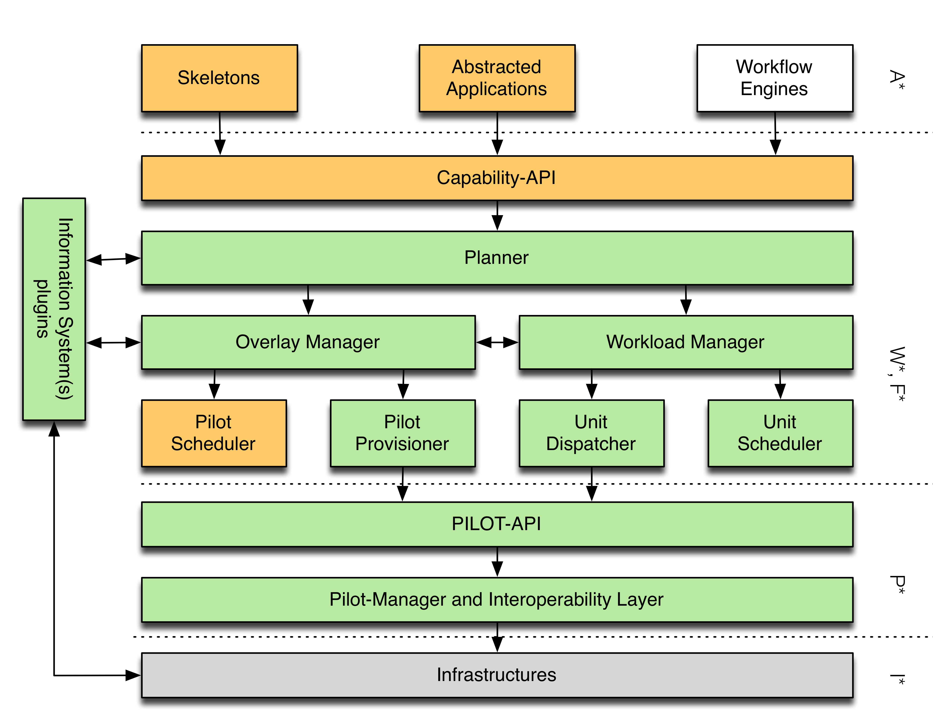
TROY: Architecture
Prototype implementation
Green: implemented.
Orange: Under development.
White: Planned.

Slide 27
NGMW Functional Aims and Requirements
Functional Aims: Well-defined Capabilities and Predictable Services
Support spatio-temporal execution reasoning
What to distribute? Where/how to distribute? When to distribute?
Estimate time to completion?
Beyond glue: Need to integrate information about applications and heterogeneous resources (compute, data and networks)
Estimate performance
Functional Requirement
Support adaptive applications in conjunction with dynamic resources
Federate heterogeneous infrastructure to provide well-defined capabilities
Notes:
Integration of Information: Applications/Services/Tools about resources – Critical role for middleware

Slide 28
NGMW Design Objectives
Does not just “glue” different layers together but:
Supports multi-level reasoning and predictable performance
Reasoning about performance
Exposes well-defined capabilities rather than technology
Capability: Well-defined and aggregated functionality, without regard to how, or the specific approach used
E.g., Num. of tasks, throughput, probabilistic bounds on time-to-completion, performance of resources, data (volumes/transfer/storage ability)
How to provide well-defined capabilities?
Single model of capability that integrates across multiple-levels and across flexible federation of resources
What are the functional property units for resources, and how to compose functionality across infrastructure?
Notes:
Can design for randomness but not for unpredictable behaviour

Slide 29
A*/W*
Analysis suggests that there are many application types
Multiple application models (Skeleton, A* = [A1, A2, A3,..])
Two-tier (A*/W*) approach supports specificity yet supports commonality
A*: Conceptual models of distributed application classes
Accompanying communication and coordination properties
Implications for application components and their distribution
A* supports the derivation of a workload representation
W* analytical model of application workload
Constituents are units of application workload which can have causal and temporal relationships (Concurrent, Sequential, Starts-After, ...)
Constituents can be transformed directly into system workload
Multiple application models can use W*
Workloads are considered static
Adaptive applications result in different workloads units
Notes:
Mostly Applications that are composed of multiple tasks – different degrees of coupling… homogenous or heterogeneous tasks
Essential Vectors of an Application: Communication, Coordination, Execution Units, Environment
Modeling Goal: Task level composition, Concurrency, Support Integrated Modeling

Slide 30
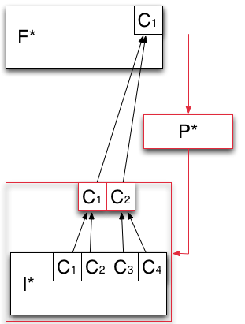
F* - Analytical Model of Resource Federation
Models how the capabilities offered by the infrastructure layer are aggregated and then exposed to the application layer.
Heterogeneous capabilities of I* are aggregated by means of overlays (red box).
P* is used to aggregate the capabilities exposed by I* into logical containers of resources (red box).

Slide 31
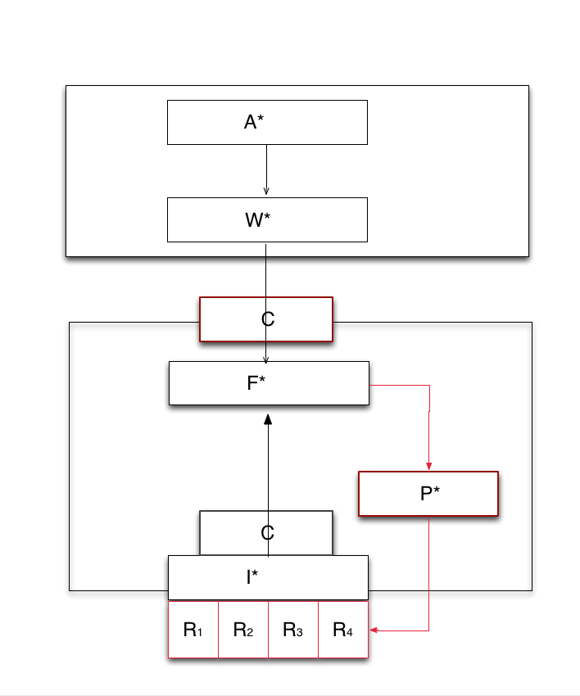
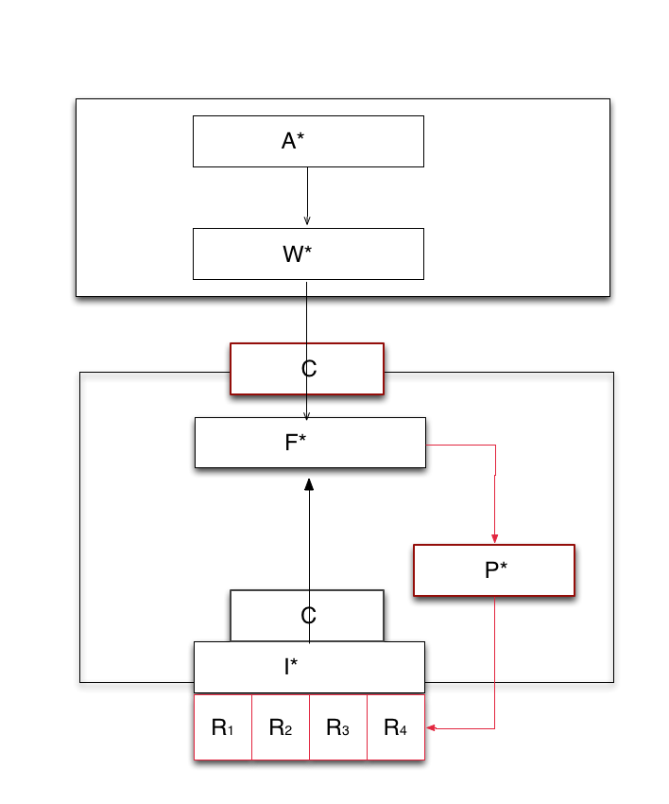
*.* : Putting it together
P*: Decouples dynamic resource management from job and task management
F*: Resource aggregation and provisioning decoupled from job and resource management
Furthers separation of concerns
C* provides, F* decides, P* executes
Federate at capability level
P* creates overlay at the resource level
Notes:
We take the schematic of NGMW and show how the different levels at which the Models work, (ii) how different models interact, especially (a) Andre and Christian’s work/interface, (ii) I* and F*.

Slide 32
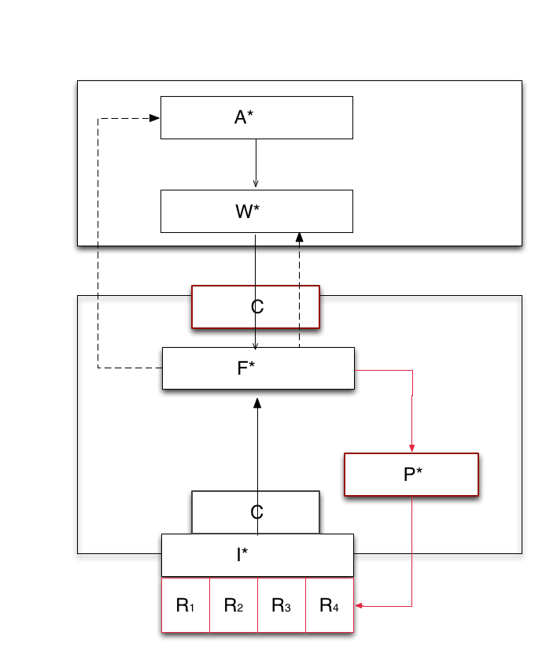
Design Objective: Multi-level Integrated Reasoning
Transformation of application workload via system workload to infrastructure capability
Application requests R(100, T,10), say 100 tasks, of type T, complete within 10 units of time
Federation Layer/Manager responds with collective capability of C(50, T, 10) or C(100, T, 20)
Adaptive Application
Adaptivity can be either at A, W level
Application may self-throttle number of tasks, or type of task generated
Or workload description can be changed to meet the capability
Notes:
We show how *.* meets the first of the design objectives of NGMW at a CONCEPTUAL LEVEL!!

Slide 33
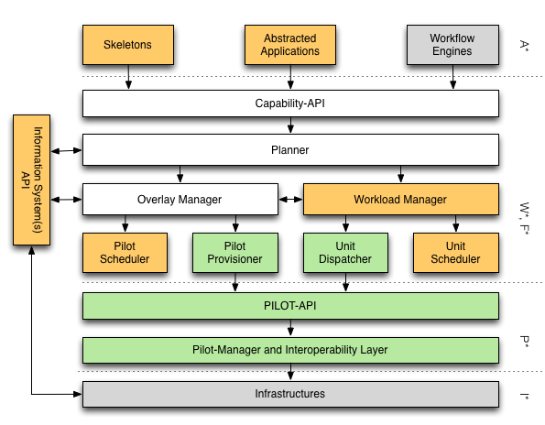
*.* : Putting it together
Notes:
We take the schematic of NGMW and show how the different levels at which the Models work, (ii) how different models interact, especially (a) Andre and Christian’s work/interface, (ii) I* and F*.

